Slide 1
NPOs in Mauritius and Terrorist Financing Risks
What you need to know, what you need to do

Slide 2
Agenda
International Measures on Terrorist Financing, and how they impact NPOs
Terrorist Financing and NPOs in Mauritius
Working with NPOs to prevent terrorist financing risks
Further resources

Slide 3
“not all NPOs represent the same level of terrorist financing risk and some NPOs represent little or no risk at all” Dr. Marcus Pleyer, FATF President In a letter to the UN Office of the High Commissioner for Human Rights, 18 December 2020
“there have been no known cases of terrorist financing abuse of NPOs in Mauritius”
NPO Terrorist Financing Risk Assessment Mauritius, 2020

Slide 4
International Measures on Terrorist Financing, and how the impact NPOs

Slide 5
The Financial Action Task Force
FATF is the international body which sets and assesses standards for combatting money laundering and terrorist financing
Mauritius is a member of ESAAMLG – the regional body for East and Southern Africa

Slide 6
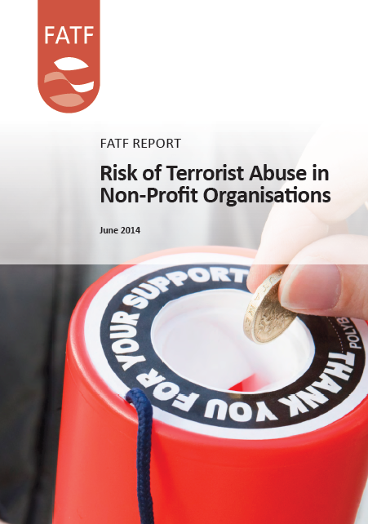
FATF’s Typologies Report (2014)
FATF’s study identified five types of international terrorist financing risk to NPOs.
Diversion of funds
Affiliation with terrorist entity
Abuse to support recruitment efforts by terrorist entities
Abuse of programming
False representation (sham NPOs)

Slide 7
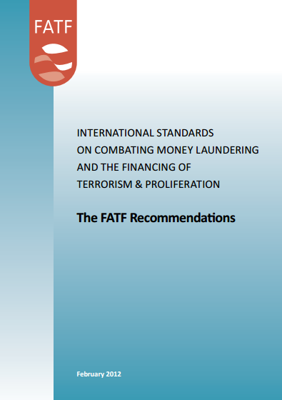
Requirements for Countries on Terrorist Financing in NPOs
FATF requires all countries to:
Identify NPOs which may be exposed to terrorist financing risks
Ensure that the measures to mitigate that risk are effective
Take a risk-based, targeted approach and not disrupt legitimate NPO activity.
(FATF Recommendation 8 and Immediate Outcome 10)

Slide 8
Recommendation 8
8. Non-Profit Organisations
Countries should review the adequacy of laws and regulations that relate to non-profit organisations which the country has identified as being vulnerable to terrorist financing abuse. Countries should apply focused and proportionate measures, in line with the risk-based approach, to such non-profit organisations to protect them from terrorist financing abuse, including:
(a) by terrorist organisations posing as legitimate entities;
(b) by exploiting legitimate entities as conduits for terrorist financing, including for the purpose of escaping asset-freezing measures; and
(c) by concealing or obscuring the clandestine diversion of funds intended for legitimate purposes to terrorist organisations.

Slide 9
A RISK BASED APPROACH TO NPO REGULATION

Slide 10
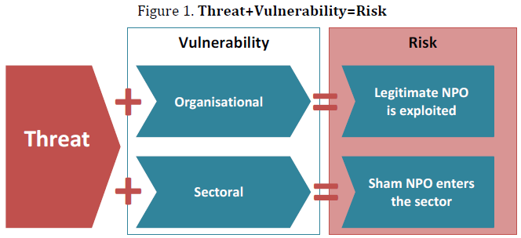
What is risk?

Slide 11
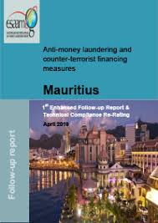
FATF Evaluation of Mauritius
Mauritius was evaluated in 2018, with a follow-up in 2019
The report highlighted
the need to do a assessment of the terrorist financing risk to NPOs
The need to do outreach to NPOs on the risk, and how to reduce it.

Slide 12
Terrorist Financing and NPOs in Mauritius

Slide 13
NPO Terrorist Financing Risk Assessment
Completed in 2020
Meets FATF requirements to:
Identify NPOs, which by virtue of their activity or characteristics, are likely to be ‘at risk’ of terrorist financing.
Identifies the nature of the terrorist financing threat to NPOs in Mauritius.
Assesses the effectiveness of measures to mitigate the risk to ‘at risk’ NPOs.

Slide 14
Scope of the Risk Assessment
The risk assessment identified the following types of NPOs as meeting the FATF definition of NPOs.
Associations
Charitable Foundations
Charitable Trusts
Companies Limited by guarantee

Slide 15
TF Risk of NPOs in Mauritius
Low-Medium

Slide 16
Nature of the TF Threat to NPOs in Mauritius
The abuse of NPOs to promote extremist ideologies.
The abuse of NPOs to finance or facilitate foreign terrorist fighters.
The abuse of NPOs to finance terrorism overseas.

Slide 17
NPOs and NPO activities likely to be at increased risk of TF abuse
1. Cross border movement of funds.
2. Alternative sources of funds and remittance systems.
3. Involvement in complex international transactions or structures.
4. Cash fund-raising from anonymous sources.
5. Ethnic or religious activities.

Slide 18
Working with NPOs to prevent terrorist financing risks

Slide 19
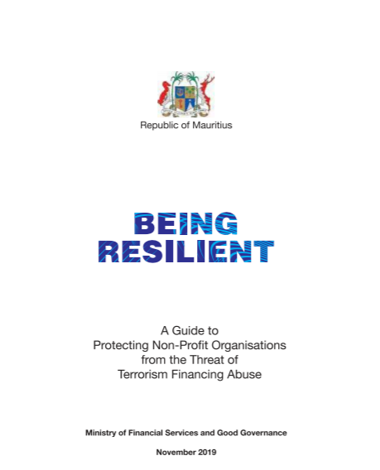
Guidance for NPOs

Slide 20
Duties of Office Holders
Eligibility to hold office.
General Duties.
Record Keeping
Financial Controls
Annual Returns
Rules

Slide 21
Model Rules for Office Holders
Model Rules for President.
Model Rules for Secretary
Model Rules for Treasurer
Model Rules for Auditor

Slide 22
Combatting Terrorist Financing Risks
All NPOs must ‘understand, identify and act’
Understand the nature of the terrorist financing risk to NPOs
Identify the risk your NPO faces
Your exposure to threat
Your vulnerability to risk
Act if needed to reduce the risk
through best practices
Financial Transparency and Accountability
Programme Planning and Monitoring
Organisational Integrity
Partner Relations

Slide 23
‘At Risk’ NPOs
Specific obligations
Refusal or removal of registration if there is support for terrorism
Obligation for auditors to report suspicious transactions
Extra vigilance for ‘at risk’ NPOs
Reasonable measures to reduce risk
Reasonable due diligence of donors, partners and beneficiaries
https://www.un.org/securitycouncil/content/un-sc-consolidated-list

Slide 24
the united nations (financial prohibitions, arms embargo and travel ban) sanctions act 2019
Section 23. Prohibition to deal with funds or other assets of designated party or listed party
(4) Any person who holds, controls or has in his custody or possession any funds or other assets of a designated party or listed party shall immediately notify the National Sanctions Secretariat of –
(a) details of the funds or other assets against which action was taken in accordance with subsection (1);
(b) the name and address of the designated party or listed party;
(c) details of any attempted transaction involving the funds or other assets, including –
(i) the name and address of the sender;
(ii) the name and address of the intended recipient;
(iii) the purpose of the attempted transaction;
(iv) the origin of the funds or other assets; and
(v) where the funds or other assets were intended to be sent.

Slide 25
39. Reporting of suspicious information
Any information related to a designated party or listed party which is known to –
(a) a reporting person, shall be immediately submitted by the reporting person to FIU in accordance with section 14 of the Financial Intelligence and Anti-Money Laundering Act; or
(b) any other person, transmitted forthwith by that person, in writing, to FIU.

Slide 26
Categorisation of countries by terrorist risk
Very High Risk | Afghanistan Iraq Nigeria Syria
High Risk | Pakistan Somalia India Yemen Philippines Democratic Republic of the Congo Mali Central African Republic Cameroon Turkey South Sudan Thailand
Medium | Colombia Sudan Kenya United States of America Niger Ukraine Mozambique Myanmar Burkina Faso United Kingdom Saudi Arabia Bangladesh Palestine Burundi Nepal Indonesia France Russia Chad Iran Israel South Africa China Lebanon Germany Greece Chile Venezuela Mexico
Low | Uganda Tajikistan Tunisia Angola Belgium Canada Sri Lanka Sweden Algeria Bolivia Spain Tanzania Bahrain Paraguay Italy Jordan Nicaragua Rwanda Peru Zimbabwe Ireland Republic of the Congo Australia Cote d' Ivoire Brazil Malaysia Kuwait Ecuador Netherlands Japan Kosovo Haiti Finland
Very Low | Madagascar Argentina Austria Kazakhstan Ghana Kyrgyz Republic Bosnia and Herzegovina Papua New Guinea Georgia Guatemala Morocco Senegal Armenia Laos Taiwan Montenegro Vietnam Honduras Guinea Denmark Czech Republic Azerbaijan Malawi Gabon Poland Jamaica Sierra Leone Lithuania Cyprus Albania Bulgaria Djibouti Zambia Macedonia South Korea Latvia Switzerland Hungary Dominican Republic Uruguay New Zealand Estonia Moldova Serbia Liberia Lesotho Norway Slovakia United Arab Emirates Panama Guyana Qatar Iceland Trinidad and Tobago Uzbekistan Bhutan
No Impact | Costa Rica Slovenia Togo Mauritania Portugal Croatia El Salvador eSwatini Mongolia Romania Benin Equatorial Guinea Cambodia Botswana Namibia Turkmenistan Mauritius Timor-Leste Singapore Eritrea North Korea The Gambia Oman Guinea-Bissau Belarus

Slide 27
Further Resources

Slide 28
A guide to protecting NPOs
https://labour.govmu.org/Documents/downloads/Being%20Resilient%20Booklet%20L.Res%20(2)%20(4).pdf
FATF typologies report on the risk of terro​rist abuse in NPOs
https://labour.govmu.org/Documents/Special%20Migrant%20Unit/Associations%20Trade%20Union/11.%20roa.pdf
FATF best practices paper on combatting the abuse of NPOs
https://labour.govmu.org/Documents/Special%20Migrant%20Unit/Associations%20Trade%20Union/12.%20roa.pdf
Terrorist Finan​cing Risk Assessment for the NPO Sector in Mauritius​
https://labour.govmu.org/Documents/Special%20Migrant%20Unit/Associations%20Trade%20Union/13.%20roa.pdf

Slide 29
Further Resources
Financial Action Task Force
Fatf-gafi.org
East and Southern Africa Anti-Money
Laundering Group (ESAAMLG)
esaamlg.org/
European Centre for Not-for-Profit Law
ECNL.org
Human Security Collective
hscollective.org
Greenacre Group
greenacregroup.co.uk
https://fatfplatform.org/
npos@fatfplatform.org
twitter (@fatfplatform)
Newsletter

Slide 30
Thank you
For your attention and participation
REGISTRY OF ASSOCIATIONS
A division of Ministry of Labour, Industrial Relations, Employment and Training
Registrar of Associations
Registry of Associations 3rd - 5th Floors
Silvercrest Court
16 Mgr Gonin Street
Port Louis
Telephone no: 2133600 Fax: 2081629
Website: labour.govmu.org

